Slide 1
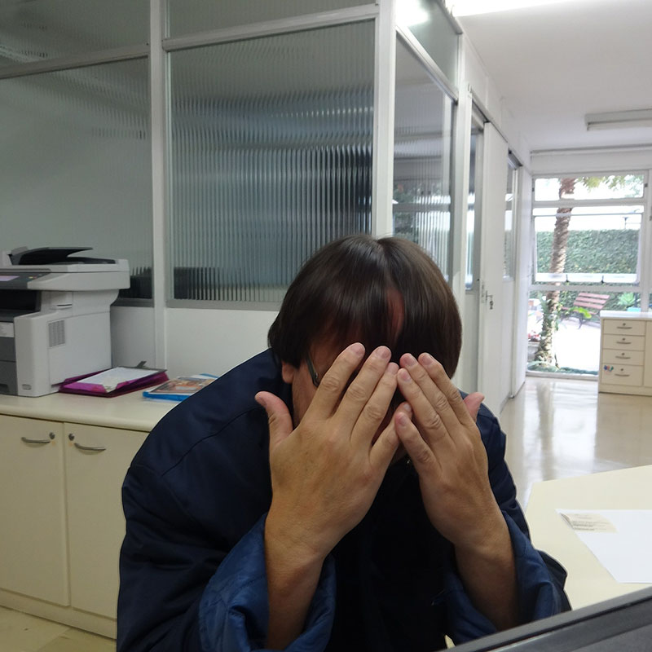
Prejudice of any kind implies that you are identified with the thinking mind. It means you don't see the other human being anymore, but only your own concept of that human being. To reduce the aliveness of another human being to a concept is already a form of violence.”
Eckhart Tolle

