Slide 1
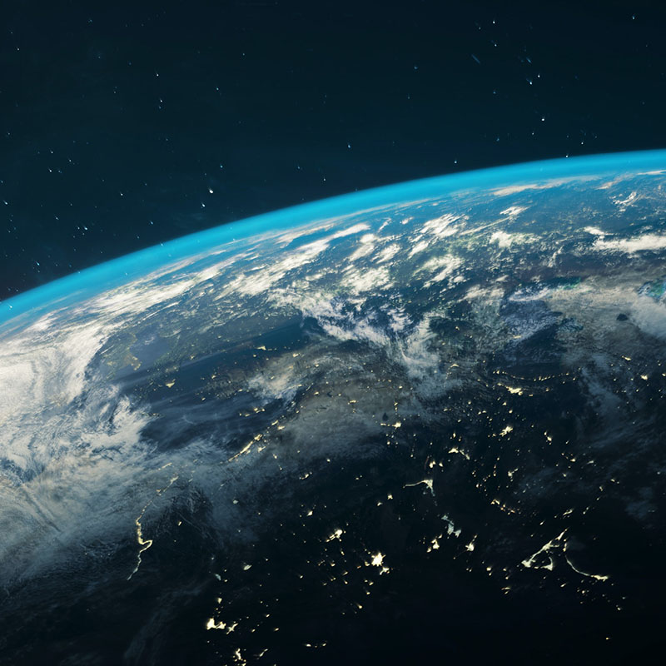
It is a strange place for us to be, this self-organizing world. If order is for free, we don't have to be the organizers. We don't have to design the world. We don't have to structure existence. We don't have to struggle to create networks, affiliations, or teams. Symbiosis is not an occasional event. Organization wants to happen. We could give up our belief that the world is falling apart, that all forms of organization are our responsibility, that it's a difficult, arduous task to create something, or to make some thing manifest. We could give up our belief that nothing happens without us.
The world knows how to create itself. We are its good partners in this process. Or we can be.
Wheatley & Rogers (1998)

